Slide 1

Summer Industrial Training
Restaurant Site
(WEB DEVELOPMENT MASTERCLASS)
Submitted by:-
Kush Mittal (181500342)
Section B

Slide 2
TECHNOLOGIES USED
HTML
CSS
JAVASCRIPT

Slide 3
HTML
HTML Development: In this section, I learned the basics of HTML5 and also how to set up my development environment, went over HTML5 basics like valid document structure, which elements can be included inside other elements and which cannot be, the meaning and usefulness of HTML5 semantic tags, and some essential HTML5 tags.

Slide 4
CSS
CSS Development: In this section, I learned to use CSS to create stylish, responsive web page layouts. Learned about parts and types of CSS rules, CSS classes, DIVs, and ID’s. Used various formatting options, including margins, padding, font properties, backgrounds, transparency, positioning, link styling, and CSS tables.

Slide 5
JAVASCRIPT
JavaScript Development: In this section, I learned to use JavaScript coding to add interactivity to static HTML and CSS pages. Learned to use JavaScript using both internal and external scripts, JavaScript output, variable declarations, arithmetic operators, objects, strings, math functions, arrays, conditional statements, loops, functions, and events.

Slide 6
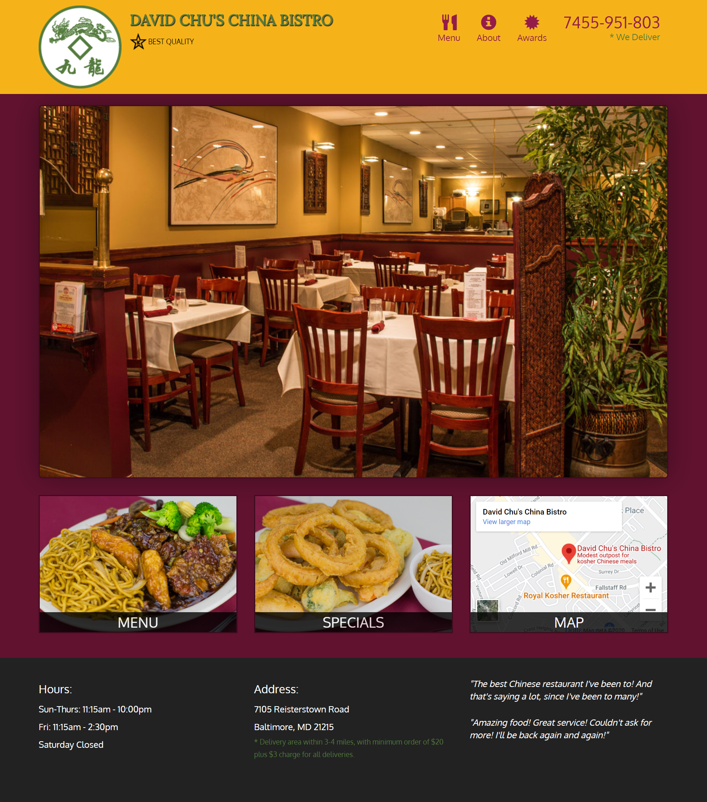
This is the front layout of the Chinese restaurant site which is made using HTML, CSS, JavaScript.

Slide 7

RESTAURANT SITE
Header:
Header contains logo of the Chinese Restaurant, Name of the Restaurant, Navigation buttons such as Menu, about, awards And telephone number to contact the Restaurant for delivery/order food items.

Slide 8
RESTAURANT SITE
Background:
Background is made simple & classy with one large size picture of the restaurant as background image followed by three equal sections named menu for selecting food items, special for some special dishes, map to locate the restaurant on google map.

Slide 9
RESTAURANT SITE
Footer:
Footer contains a row sections of opening and closing hours/timing of the restaurant, address of the restaurant, an quote on the restaurant.

Slide 10
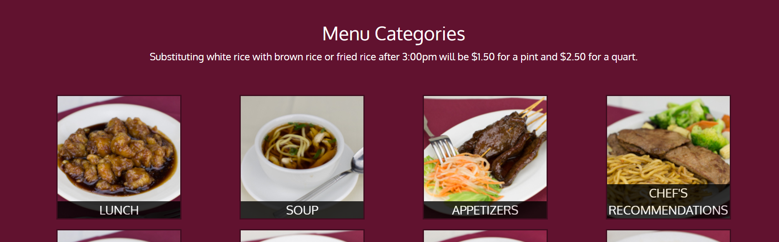
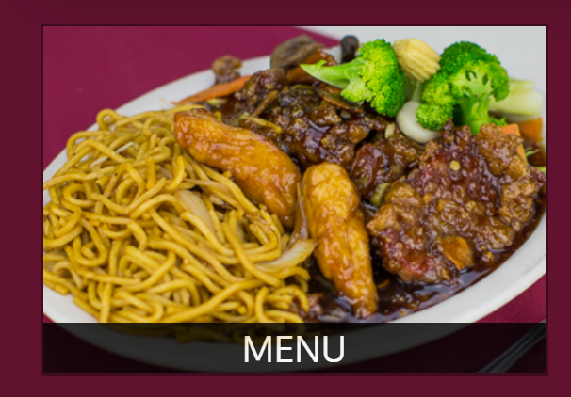
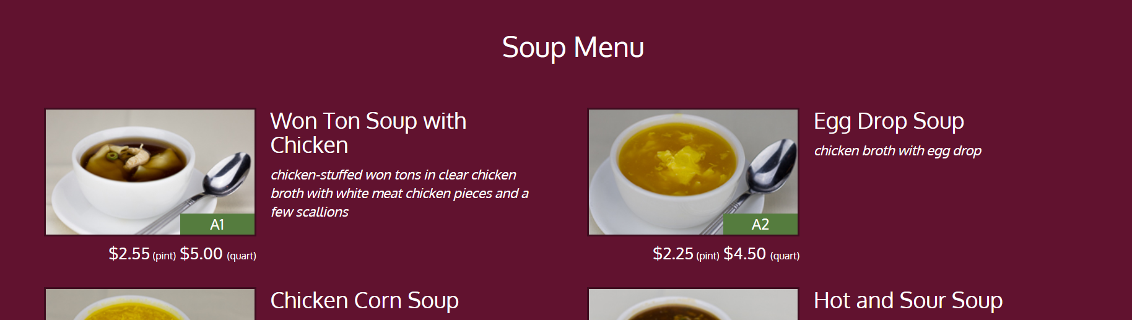
RESTAURANT SITE
→→→→→→→
→→→
Menu:
In Menu we have used anchor tag to link menu with the menu page where we have Lunch, Soup, Appetizers, chef’s recommendation & all the things like that.
After this page, Suppose the user clicked on Soup section then it will take user to a new page where all the types soup images are present along with every dish name, price & a short description.

Slide 11
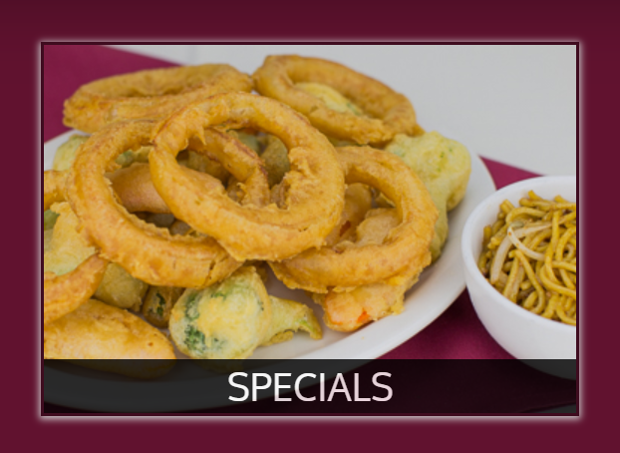
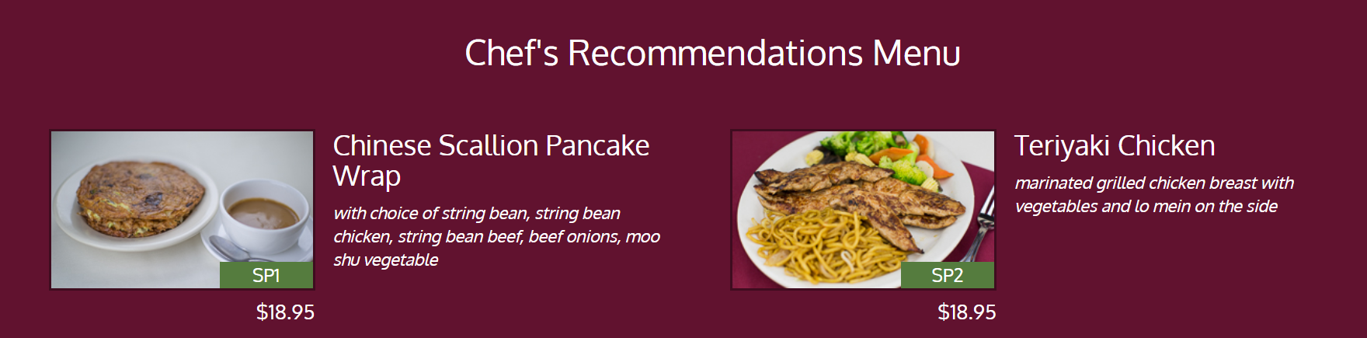
RESTAURANT SITE
Special section directly takes user to the special items web page.
→→→→

Slide 12
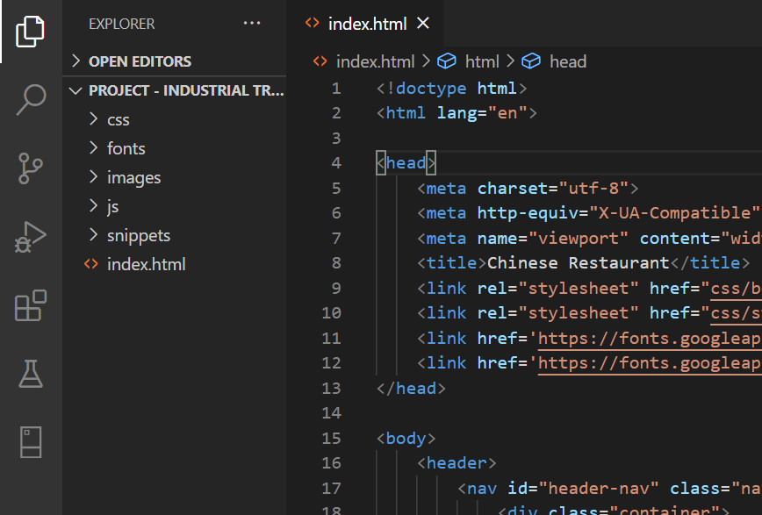
RESTAURANT SITE
Folders in Code:

Slide 13
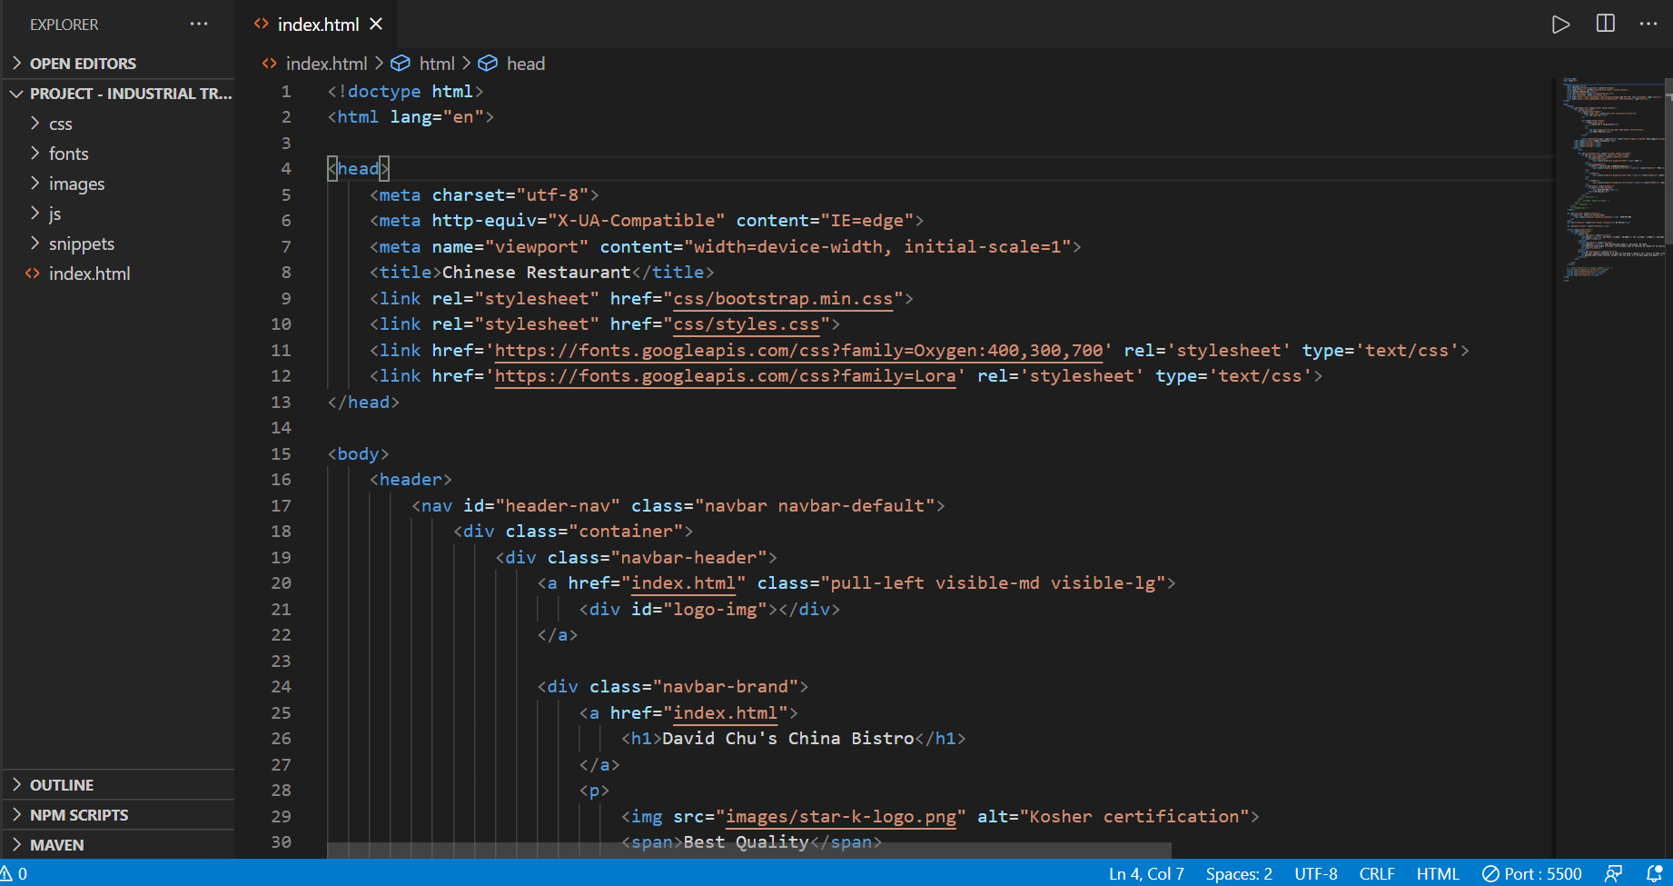
RESTAURANT SITE
INDEX.html :

